Slide 1

Flight Passenger Analysis Using Python.
BI CASE STUDY

Slide 2
Project Overview :
In this project we have analysed a dataset of an Airline company. Through our analysis we’ve found some important key factors through which we can bring in more passengers and shall have the positive impact on their journey.
When passengers are planning their travels, they consider variety of factors like:-
Ticket prices
Airline awareness & reputation
Brand loyalty
Cleanliness
Flying history etc
So in our given dataset we have some ratings data given by passengers regarding the experience and service of airline company, we’ll see what they indicate in further analysis.
Python Libraries used – Numpy, Pandas, Matplotlib, Seaborn.

Slide 3
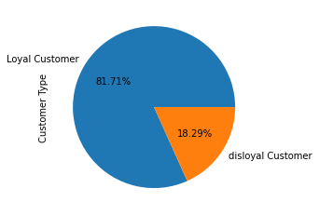
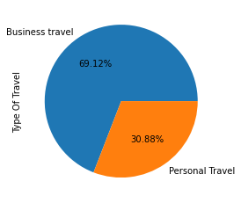
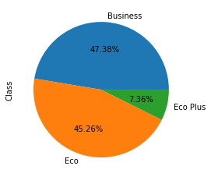
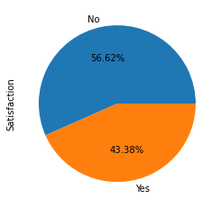
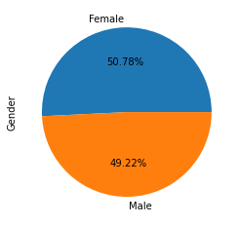
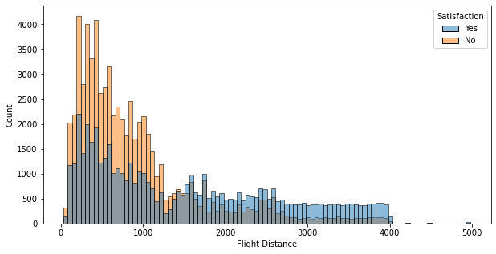
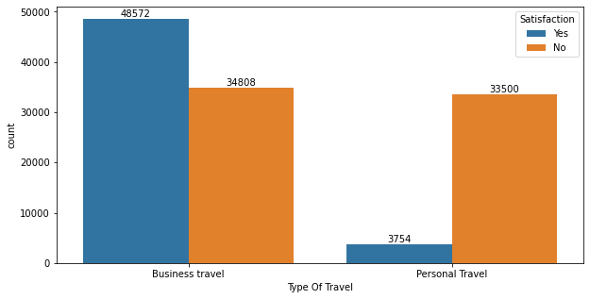
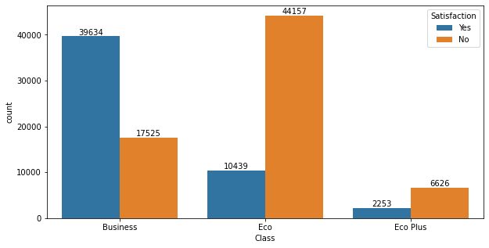
Univariate and Bivariate Analysis
The airline have very strong loyal customer base. | Passengers are majorly traveling for the business purpose. | Passengers are majorly distributed in business class and eco class. | More than 50% customers are not satisfied with the airline service.
Gender have no role to play over the customer satisfaction. | Passengers which travel for the business purpose are more than personal travellers and so they’re satisfied with the services. | Passengers are more satisfied with the services of business class than any other. And most dissatisfied with the eco class. | Passengers are satisfied with the services for longer flight distance and vice versa.

Slide 4
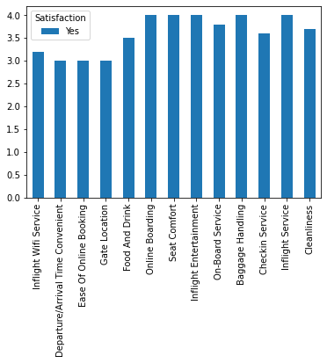
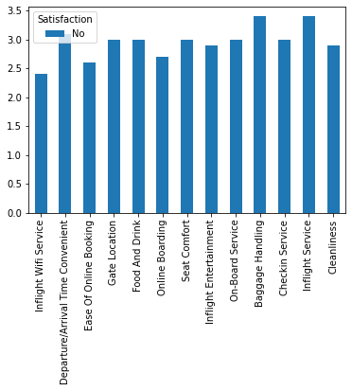
Passenger satisfaction rating as per airline services.
The Airline should improve the below services to improve customer satisfaction:
1. Inflight wifi service. 2. Departure/Arrival time convenient. 3. Ease of online booking.
4. Gate location. 5. Food and drink 6. Baggage handling.

Slide 5
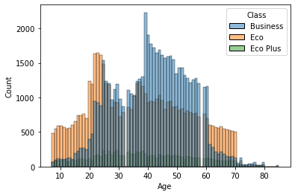
Travel class among diff age group.
Dominant age group for business class is 40 years of age.
Dominant age group for eco class is between 20 t0 25 years of age.
For the eco plus class the age group is widely distributed.

Slide 6
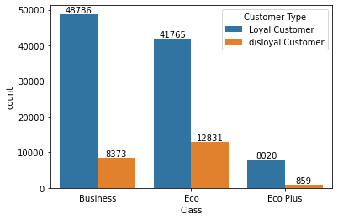
Type of customers among the travel class.
Here we identify that the airlines loyalty program mostly consists the passengers of business class.
Also the count of loyal customers is greater than the disloyal customers across all the travel classes.
From this the marketing team can strategies their marketing gimmicks to attract the passengers towards eco plus travel class.

Slide 7
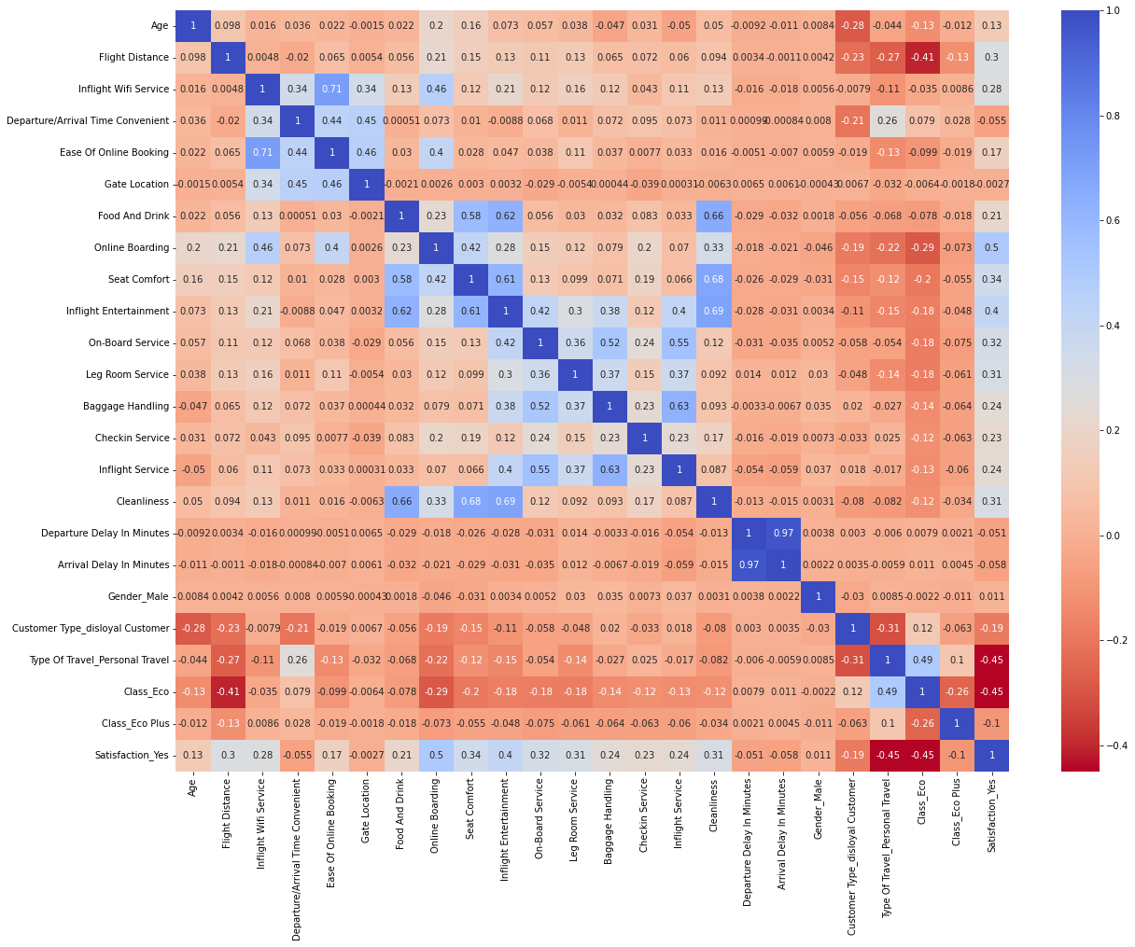
Correlation of dataset.

Slide 8
THANK YOU

